Slide 1
80
Discrete Mathematics
Introduction to Trees

Slide 2
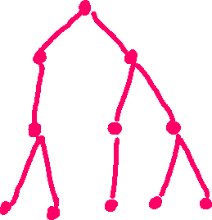














Slide 3








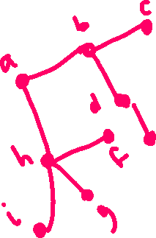


Slide 4
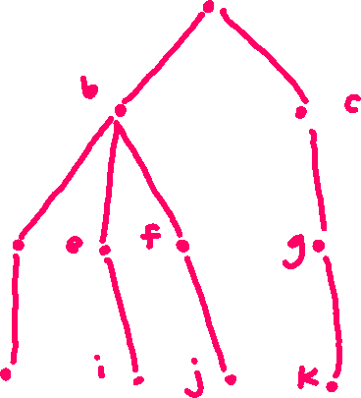











Slide 5


























Slide 6







Slide 7
Up Next…
Combinatorics/Discrete Math II

